Slide 1
Plan and Schedule
3.26 - 3.28(meeting)
Read the paper that explain the modular and integrative function of human brain.
3.29 - 4.1(meeting)
Illustrate the modular functional architecture of human brain.
Define the components.
4.2 - 4.6(meeting)
Explain how nodes are clustered and modules are formed.
Think (from machine-learning’s perspective) about how information is transferred between modules.
Understand the dynamic change of Modular Functional Architecture when more cognitive functions (0-3 or more) are engaged.
Discuss about what will be the significance of above discussed nodes in designing our neural network.
Notes:
Think (from machine-learning’s perspective) about how information is transferred between modules.

Slide 2
Plan and Schedule
4.7 - 4.9(meeting)
Summarize all the assumptions mentioned in the paper.
Find a reasonable use case to apply the model.
Reflect on how to bring the modular architecture to machine learning (GANs). Consider how we will take the idea of Connector node in proposing our GANs network.
4.10 - 4.12(meeting)
Read the paper “Learning to Write with Cooperative Discriminators”
Find use cases that can divided into sub-problems, reflect and discuss on how to bring the modular architecture to this scenario using multiple discriminators.
4.13 - 4.15(meeting)
Reread “Learning to Write with Cooperative Discriminators”
List all possible modularized architectures, define their local objective, global objective and integration, and find the most reasonable architecture (according to human brain’s modular architecture)

Slide 3
Plan and Schedule
4.16 - 4.19(meeting)
Summarize insight gained from the modular paper.
Think from GAN’s perspective about the structure, focusing on the local and global objective, the way modules integrate.
4.20 - 4.24(meeting)
Implement on basic GAN
Choose dataset: moving MNIST. Preprocess the data.
4.25 – 5.4
Plan: New architecture; Add one use case of text-t-image generation.
Progress: The first module done; Moving MNIST data processed and run with results.

Slide 4
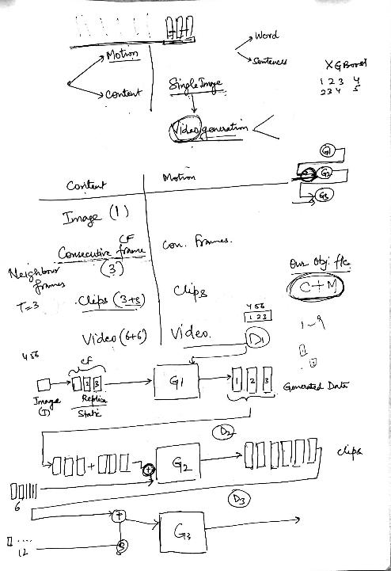
Meeting Minutes and Progress
Plan from 4.19
Implement one module of MIGAN
Progress before 4.19
Summarize insight gained from the modular paper.
Think from GAN’s perspective about the structure, focusing on the local and global objective, the way modules integrate.

Slide 5
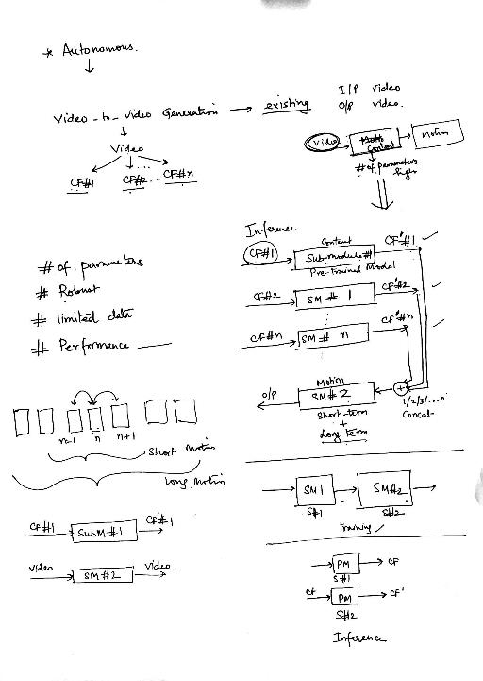
Meeting Minutes and Progress
Plan from 4.24
New architecture;
Add one use case of text-to-image generation.
Progress before 4.24
Implemented on basic GAN
Chose dataset: moving MNIST. Preprocess the data.

Slide 6
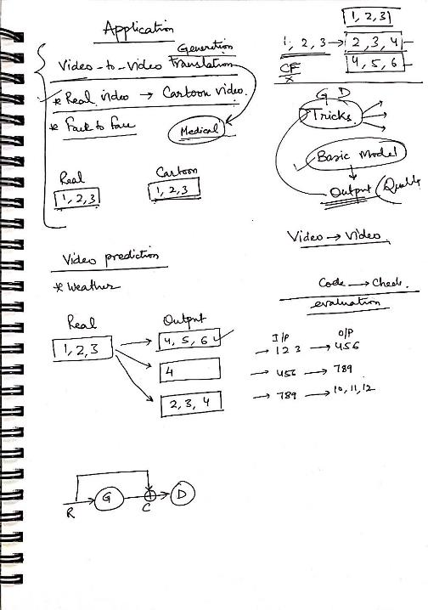
Meeting Minutes and Progress
Plan from 5.4
First: build whole structure for video prediction case, with short-term motion + long-term motion objective functions.
Second: evaluation + refine module structure
At the same time, go for vid2vid translation, look for medical datasets/cases (if possible)
Progress before 5.4
The first module done; Moving MNIST Data processed and run with results.

Slide 7
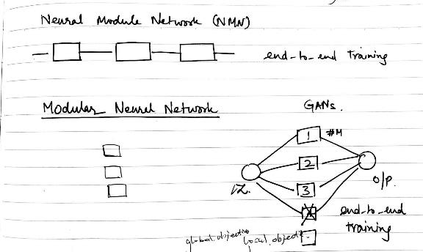
Meeting Minutes and Progress
Meeting minutes on 5.11
Our contribution
Existing works: NMN, multistage network, MNN
Plan from 5.11
Define research problem
Implement short term motion
Modify input and output for video prediction
Progress before 5.11
Module 2 structure done

Slide 8
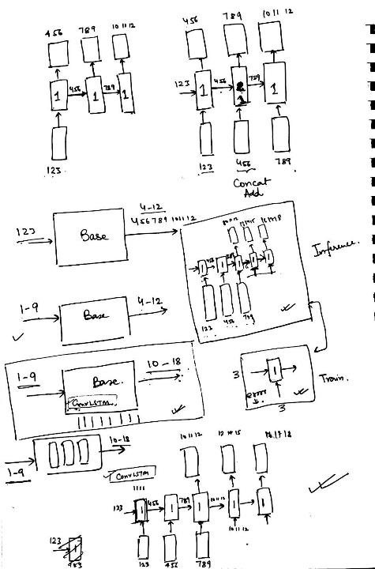
Meeting Minutes and Progress
Meeting minutes on 5.19
Plan from 5.19
Progress before 5.19

Slide 9
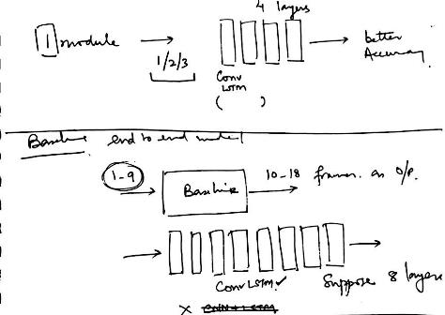
Meeting Minutes and Progress
Meeting minutes on 5.19
Plan from 5.19
Progress before 5.19

Slide 10
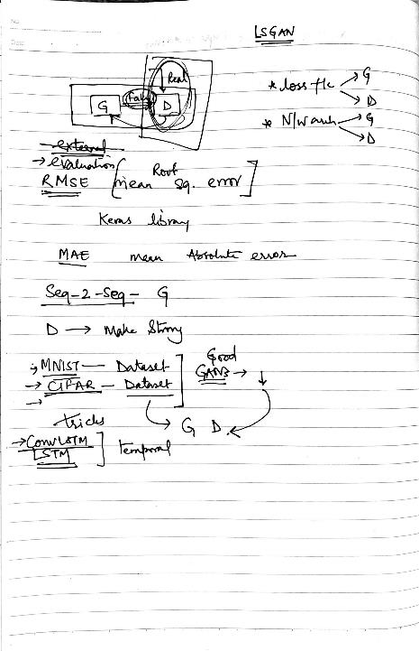
Meeting Minutes and Progress
Meeting minutes on 5.24
Plan from 5.19
Progress before 5.19

Slide 11
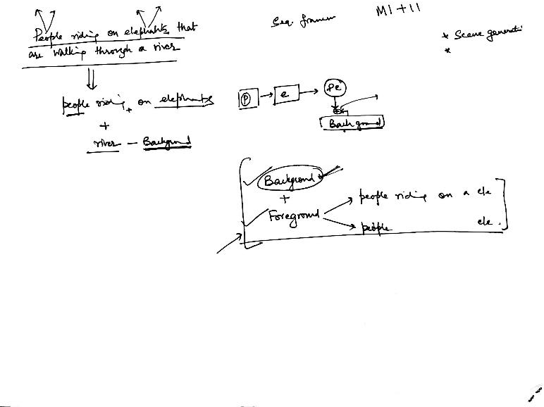
6.15
Discuss the structure of foreground and background module for text-to-image generation

Slide 12
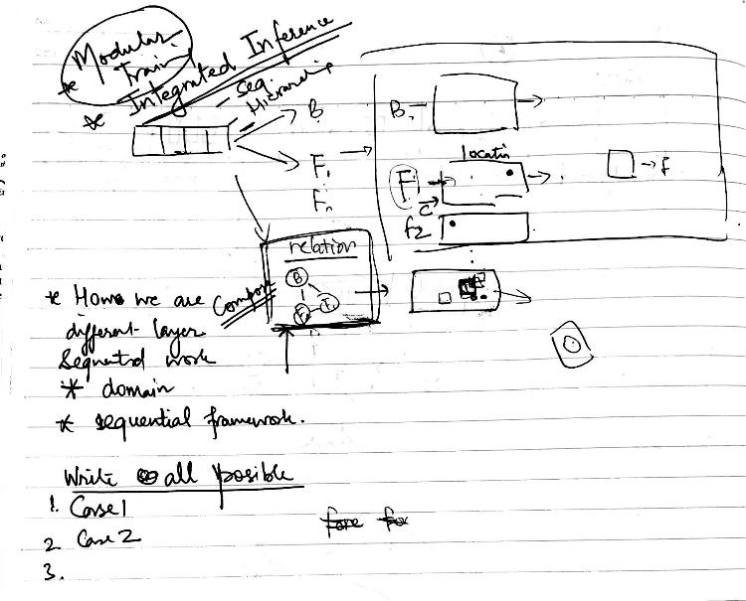
6.16
Discussed compose module (future work)
Background done. Difference between sequential layered paper.
1.Search text 2 image papers
2.Think and discuss all possible designs (input, output, paired/unpaired dataset) of foreground module with different model structure (sequential / parallel) for training and inference.

